Slide 1


K.RAMAKRISHNAN COLLEGE OF TECHNOLOGY
(AUTONOMOUS), TRICHY.
DEPARTMENT OF
COMPUTER SCIENCE AND ENGINEERING
20CS5501 DESIGN PROJECT-1
Batch No. : 11
Date : 06.12.2024

Slide 2
PEER GRADE HUB
Guided by Team
Mr. R.JASMINE ,ME Kishore M (811722104078)
Assistant Professor, CSE Kishore M (811722104079)
Madhavan P (81172210484)

Slide 3
OBJECTIVE OF THE PROJECT
Provide a user-friendly platform for online assignment submission and peer reviews.
Facilitate efficient peer grading to improve student learning and feedback quality.
Automate assignment management tasks to reduce teacher workload.
Promote fairness and transparency in the peer grading process.
Enhance student collaboration and encourage teamwork through shared evaluations.
Develop critical thinking and analytical skills in students by involving them in the grading process.
Ensure accessibility for users with different levels of technical expertise.
Build trust and engagement in the learning environment by ensuring constructive feedback.
Offer real-time tracking of assignments and reviews for better organization.

Slide 4
ABSTRACT
Grading system is an innovative online platform designed to streamline the assignment submission, peer grading, and feedback process in educational environments. It aims to simplify the way students and teachers interact with assignments and grading
Students can easily submit their assignments, engage in peer reviews, and provide detailed feedback on each other’s work, promoting a deeper understanding of the subject matter.
This collaborative approach helps students improve their critical thinking, communication, and analytical skills by learning from their peers’ work and insights.For teachers, the platform offers tools to manage assignments, set deadlines, and track student progress with minimal effort.
The platform is also scalable, meaning it can be easily adapted to different educational institutions, ranging from schools to universities. It can handle various types of assignments and grading systems, making it flexible enough to meet diverse academic needs.

Slide 5
TITLE OF THE PAPER | AUTHOR (S) | PUBLISHER | PAPER GIST | TECHNOLOGY USED
Automated Marking of individualised Spreadsheet Assignments (2022) | Paul Blayney, Mark Freeman | Australasian Society for Computers in Learning in Tertiary Education (ASCILITE) | The paper examines how automated grading and self-assessment of individualized spreadsheet assignments can improve learning. | The technologies used in the paper include web-based learning management systems like Stable Matching Algorithm.
Connecting teacher and student assessment literacy with self-evaluation and peer feedback | Christopher C. Deneen & Hui-Teng Hoo | Assessment & Evaluation in Higher Education | The paper explores the relationship between teachers' feedback literacy, curriculum design, and students’. | The project likely utilized peer feedback systems, self-evaluation frameworks, and teacher-guided scaffolding.
Students’ reflection on immediate feedback during formative assessment | Purva B Hathila1 , Dipika P Baria2 , Chintan K Damor3 , Swati Mahajan2 | National Journal of Physiology, Pharmacy and Pharmacology | This study evaluated the impact of immediate feedback on medical students' learning using interactive MCQ modules. | The technology used in this project includes "Hot Potatoes" software (version 6.3) to create interactive MCQ modules and WhatsApp as a platform to deliver the tests.
LITERATURE SURVEY

Slide 6
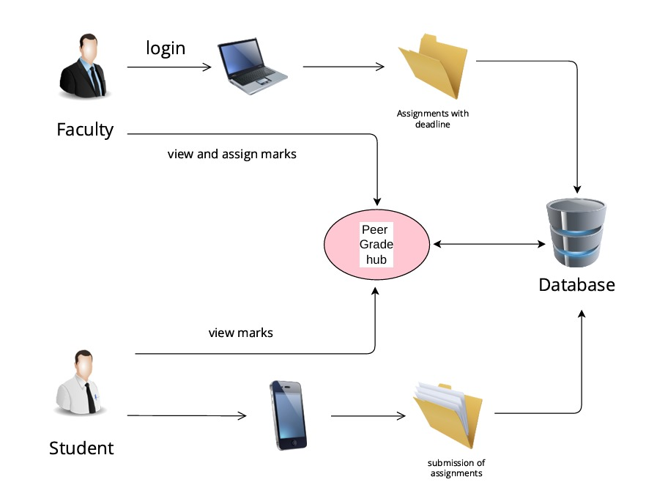
PROPOSED SYSTEM ARCHITECTURE

Slide 7
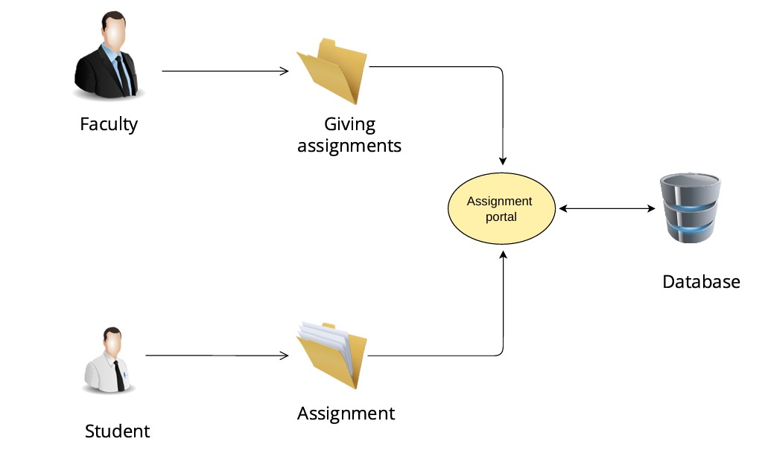
EXISTING SYSTEM ARCHITECTURE

Slide 8
SOFTWARE AND HARDWARE REQUIREMENTS
HARDWARE
SOFTWARE
Cloud Hosting: MySQL.
Local Development Machine:
Processor: Intel i5 or higher.
RAM: 8 GB (16 GB recommended).
Storage: 256 GB SSD or higher.
Stable Internet Connection.
Languages: HTML, CSS, JavaScript, PHP.
Libraries: Bootstrap, Tailwind CSS.
Database: MySQL.
Version Control: Git with GitHub.

Slide 9
MODULES
User Authentication & Authorization Module
Assignment Submission Module
Peer Review Module
Grading & Feedback Module
Dashboard Module

Slide 10
SUMMARY OF MODULE-1
User Authentication & Authorization Module:
Purpose: Handle user registration, login, and role-based access (student, faculty).
Components:
User Sign Up & Login (username-based).
Role-based access control (RBAC) to manage different permissions for students and facultys.
Profile management.
Reasoning: This is fundamental for any user-specific platform, ensuring secure access and role differentiation

Slide 11
SUMMARY OF MODULE-2
Assignment Submission Module
Purpose: Allow faculty’s to create and manage assignments, and students to submit them.
Components:
Create assignments (Faculty): Set deadlines, descriptions, and attach files.
Submit assignments (Students): Upload files or write responses online.
Track submission deadlines.
View and edit submitted assignments before the deadline.
Reasoning: Core functionality for enabling students to submit work and faculty’s to receive it.

Slide 12
SUMMARY OF MODULE-3
Peer Review Module
Purpose: Enable students to review and give feedback on each other’s assignments.
Components:
Random or faculty-assigned peer review matching.
Rubric-based or free-form feedback submission.
View feedback received from peers.
Reasoning: This is the key part of the platform that helps students learn from each other by reviewing and giving feedback on each other's work.

Slide 13
SUMMARY OF MODULE-4
Grading & Feedback Module
Purpose: Allow Faculty’s to grade assignments and provide feedback, as well as review peer feedback.
Components:
Faculty grading and feedback (rubric-based).
Automatic feedback summary from peer reviews.
Export grades and feedback.
Reasoning: This gives faculty’s the tools to grade assignments and include feedback from students' peer reviews

Slide 14
SUMMARY OF MODULE-5
Dashboard Module:
Purpose: Provide a centralized view for students and faculty’s to manage assignments and reviews.
Components:
Student dashboard: View assignments, deadlines, submissions, and peer reviews.
faculty dashboard: Manage assignments, view submissions, and assign peer reviews.
Reasoning: Simplifies navigation for both students and faculty’s, offering a clear interface to manage tasks.

Slide 15
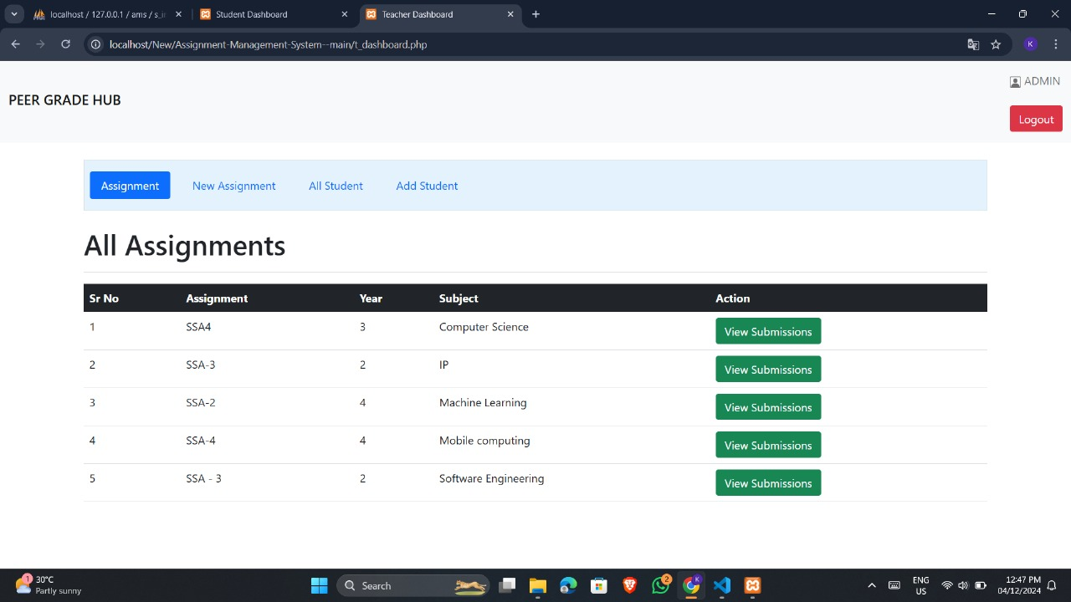
RESULTS AND DISCUSSION
The platform aims to provide a space where students can give and receive meaningful feedback, helping them improve their understanding and skills.

Slide 16
CONCLUSION
Better Feedback: The mix of tutor and peer feedback helps students understand academic standards more clearly, giving them valuable input from both their teachers and fellow students.
Thoughtful Reflection: The feedback analysis tool helps students think carefully about the feedback they receive, guiding them to spot areas for improvement and track their learning progress over time.
Scalability: By using cloud technology (Azure or AWS), PeerGradeHub can handle large numbers of assignments and feedback reliably, making it a good fit for educational institutions of all sizes.
Useful Reports: The reporting and analytics feature gives teachers and administrators helpful insights into student performance, allowing them to make better decisions to improve teaching and learning.

Slide 17
THANK YOU

